Slide 1

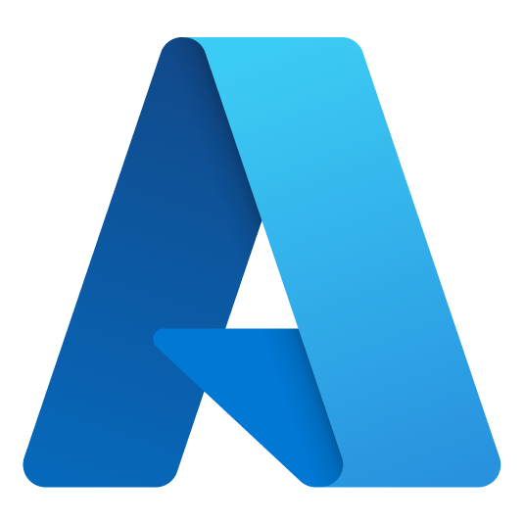



Arsene Nsaha
Cloud Solution Architect
Azure Dev Day
anguezangnsa@microsoft.com
https://www.linkedin.com/in/arsenensaha
https://github.com/ArseneMS
Notes:
Introduce yourself

Slide 2
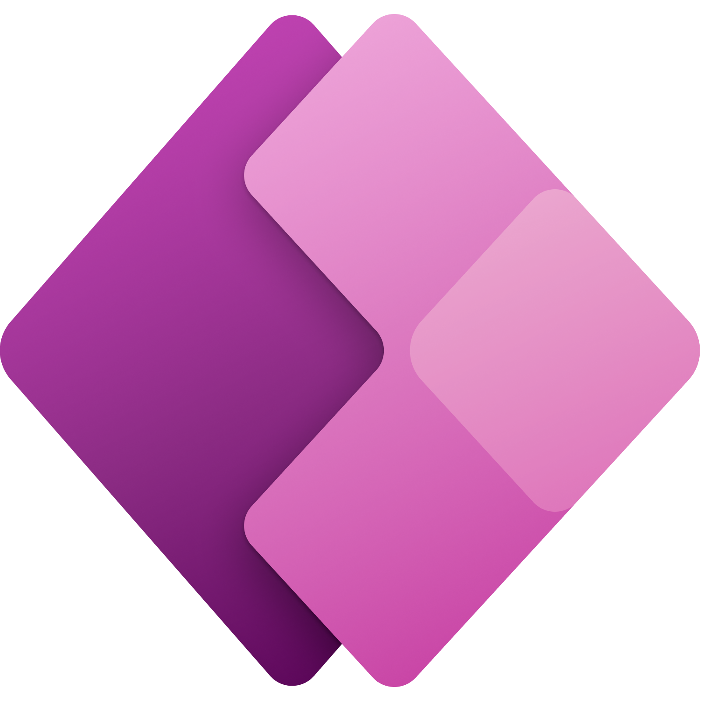
Power Apps
Rapidly building and hosting front end applications.

Slide 3




Power Platform
Power BI
Business Analytics
Power Apps
Application Development
Power Automate
Process Automation
Virtual Agents
Intelligent Agents
Data connectors
AI Builder
Microsoft Dataverse
(Common Data Service)
Power Functions
Notes:
The Microsoft power platform is a function as a service enterprise grade solution built on azure . By default it inherits the same level of enterprise-grade security, certifications and administrative controls as Azure.
The Microsoft Power Platform implements this vision via 4 primary cloud-based services: Power BI, PowerApps and Power Automate, and Power Virtual Agents.
These services connects to hundreds of business systems and databases, making it easy to connect users with the existing processes and data that makes the business tick.
Additionally, Power Platform comes with a built-in, fully-managed, enterprise-grade datastore called the Common Data Service (CDS) for those applications that generate data not destined for a legacy system or SharePoint List.
Power BI: Business analytics with AI infused backend that out of the box identifies patterns and relationships in your data set.
With Power BI Desktop, you can build advanced queries, models, and reports that visualize data. You can also build data models, create reports, and share your work by publishing to the Power BI service.
Power Apps: Apps built using Power Apps provide rich business logic and workflow capabilities to transform your manual business operations into digital, automated processes. What's more, apps built using Power Apps have a responsive design and can run seamlessly in browser and on mobile devices (phone or tablet). Power Apps "democratizes" the business-app-building experience by enabling users to create feature-rich, custom business apps without writing code. Build UI easily to bind the data together. Can add React and offce UI frabric to improve the User Interface of your power apps
Power automate:
Automate business processes
Send automatic reminders for past due tasks
Move business data between systems on a schedule
Connect to more than 700 data sources or any publicly available API
You can even automate tasks on your local computer like computing data in Excel.
You can create flows to replicate common manual repeatable tasks
Power Virtual Agents lets you create powerful chatbots that can answer questions posed by your customers, other employees, or visitors to your website or service.
Data Connectors
A connector is a proxy or a wrapper around an API that allows the underlying service to talk to Microsoft Power Automate, Microsoft Power Apps, and Azure Logic Apps. It provides a way for users to connect their accounts and leverage a set of prebuilt actions and triggers to build their apps and workflows
AI Builder
AI Builder is a Microsoft Power Platform capability that provides AI models that are designed to optimize your business processes. AI Builder enables your business to use intelligence to automate processes and glean insights from your data in Power Apps and Power Automate
Microsoft Dataverse
Dataverse lets you securely store and manage data that's used by business applications. Data within Dataverse is stored within a set of tables. A table is a set of rows (formerly referred to as records) and columns (formerly referred to as fields/attributes)
Power Functions
Power Fx is the low-code language that will be used across Microsoft Power Platform. It's a general-purpose, strong-typed, declarative, and functional programming language.
Power Fx is expressed in human-friendly text.

Slide 4

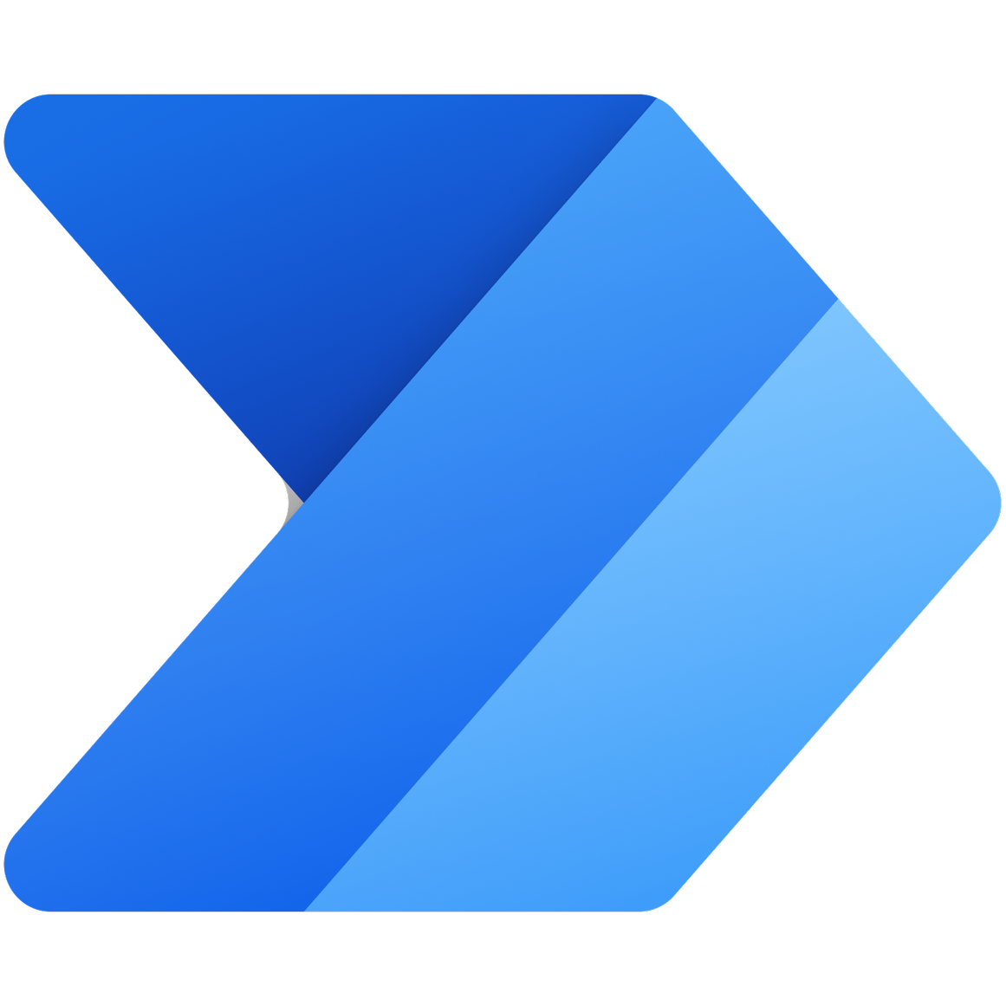



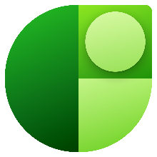

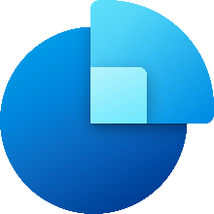
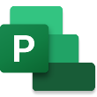
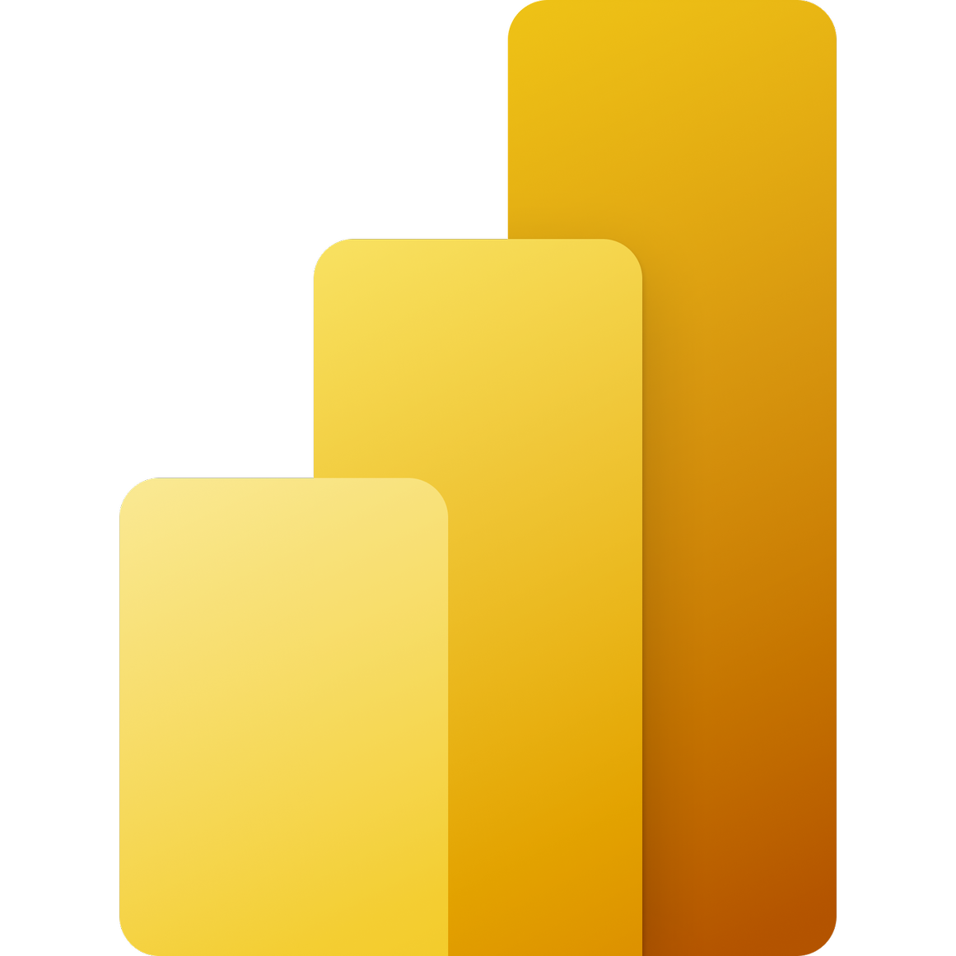
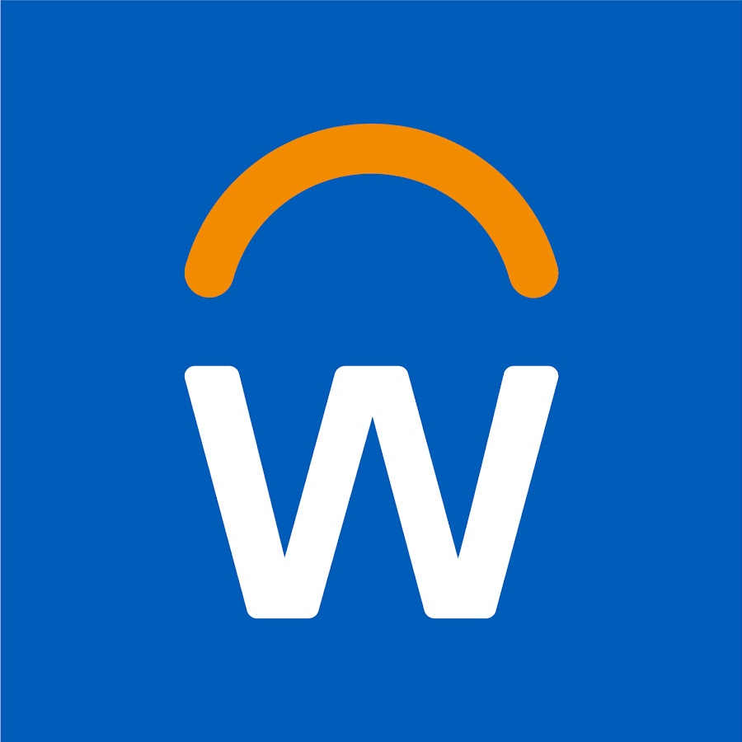
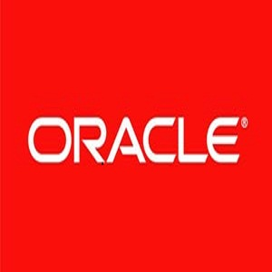

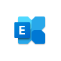
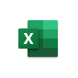


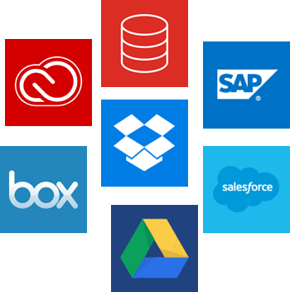
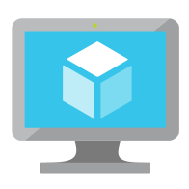

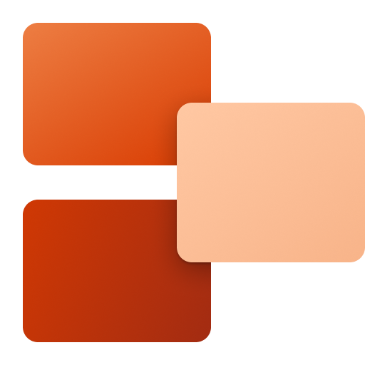

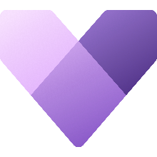
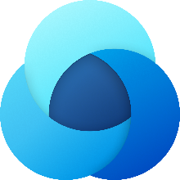






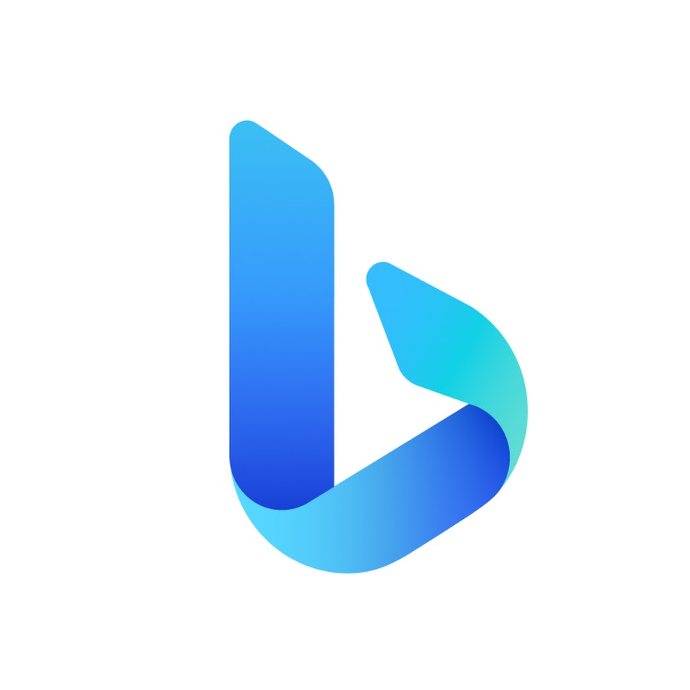
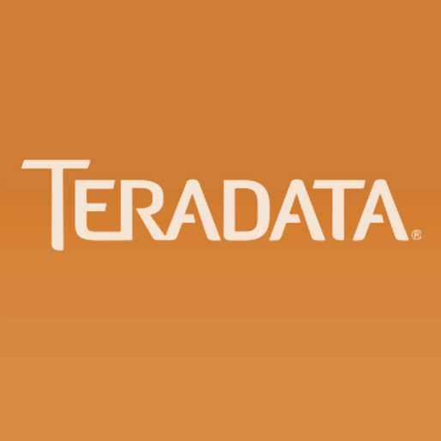
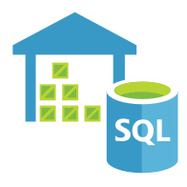
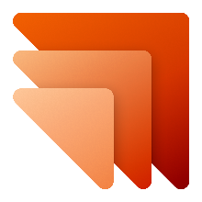
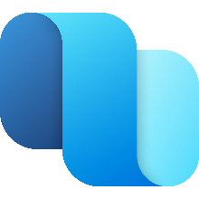
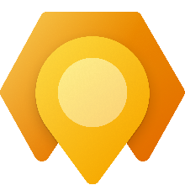



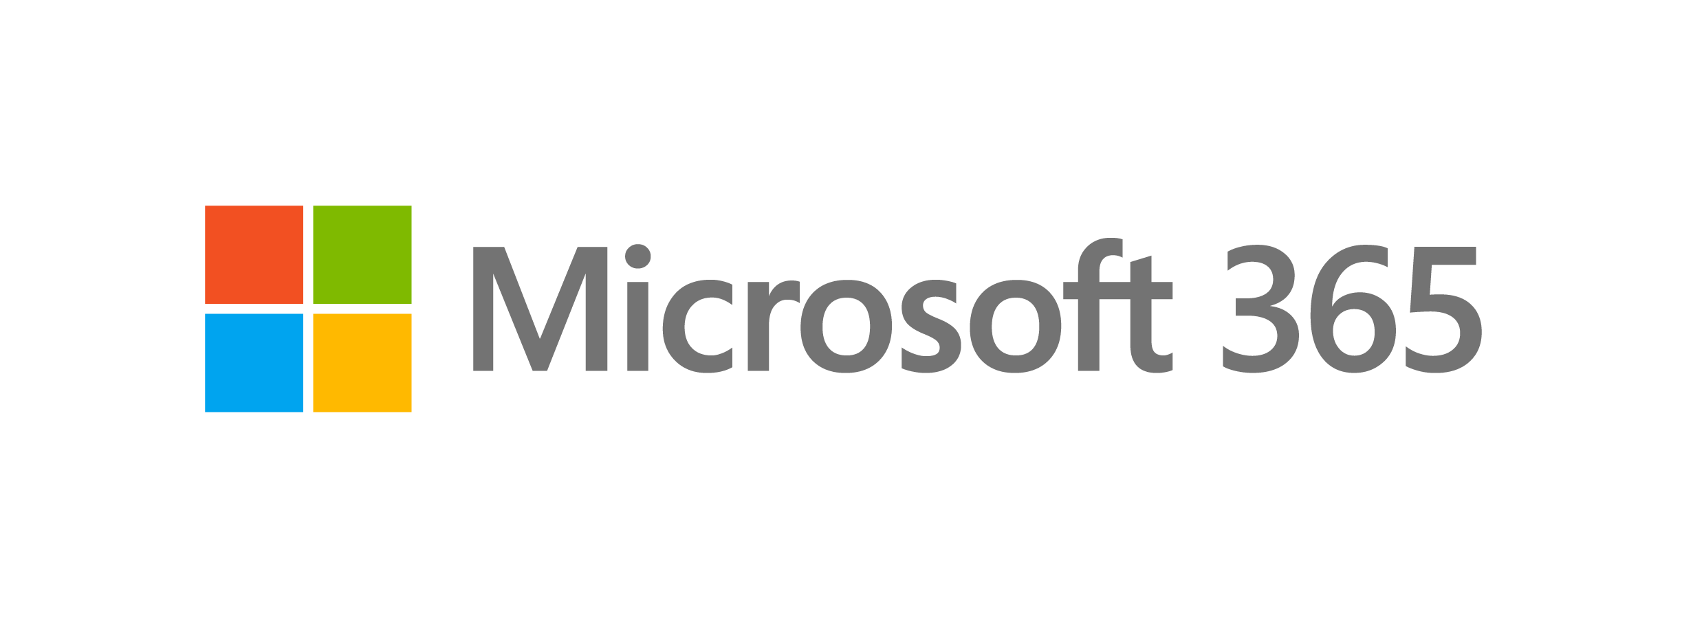
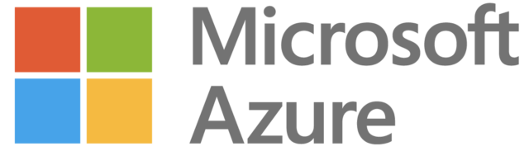
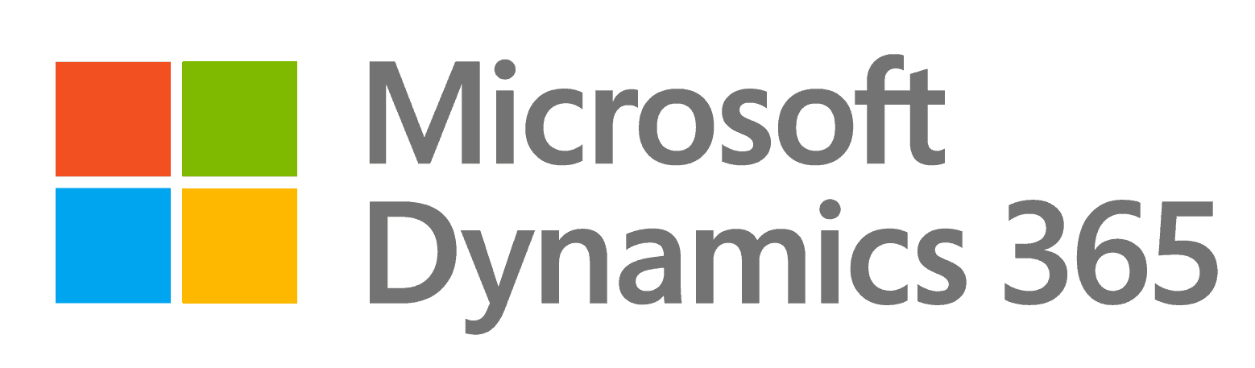
Power Platform Connects to all your data – 700+ Connectors + Custom
POWER APPS
POWER AUTOMATE
Other Microsoft
3rd Party Enterprise
Power Platform supports a rich ecosystem of connectors across Microsoft and non-Microsoft cloud and on-prem services
Notes:
The ‘power’ of Power Platform is inherent in the rich and ever-expanding ecosystem of 700s of Microsoft and non-Microsoft service connectors that can be leveraged in your apps and flows. These connectors provide you a declarative no code/low code way to connect your apps and flows to more than 300 cloud services. They also allow you to use data gateway model to connect to your on-prem resources. Not only that, you can build your own custom connectors to service endpoints and bring them into the power platform.
And as they say, with great power comes great responsibility. The key to harness the tremendous power of this uber connected data platform in a safe and secure way - is the ability to segregate business data from non-business data. An organization’s data is its key asset and we realize that preventing data exfiltration is a non-negotiable tenet for our customers.

Slide 5









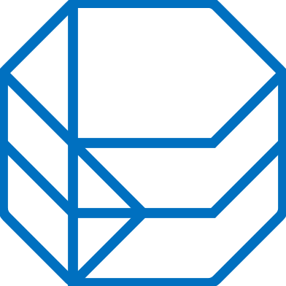


Add even more power to the Power Platform Azure+ Power Platform = No Limits
Power Platform
Developer (Low Code)
Power Apps
Power Automate
Power Virtual Agents
Power BI
Azure Services
Developer (Code First)
Analysis
Services
API Management
Azure Functions
Kubernetes Service
Logic
Apps
Cognitive Services
Bot
Services
Azure / Office
Data Services
Dataverse
Visual
Studio
VS
Code
Microsoft
Graph
Azure Synapse Analytics
Cosmos DB
Notes:
developers can easily extend the automation, analytics and apps line-of-business to leverage Azure services like Functions, App Service, and Logic Apps. API connectors, gateways, and Common Data Service make it possible to get more value out of services or data already in use, either in the cloud or on-premises.

Slide 6






Azure + Power Apps = Rapid Application Development
Developer
Custom controls and connectors
Developer
Power Apps
Power Automate
Power Virtual Agent
Power BI
Notes:
Developers can use DevOps tools like Azure DevOps and Github in combination with Azure to build custom controls and connectors for the power platform. You can perform all the Software Development life cycle phases with power apps as you would normally do it. The concept of Rapid Development takes full flesh with power apps. App building is more about understanding the business processes and designing it than focusing on complex technical details and processes.

Slide 7
Custom Connectors
Azure API management gateway
Connector ID
+
Operation
+
Connection ID
________
Host
+
Path
+
Credentials
__________
Custom connector
Custom web API
Power Automate
Connection ID
Credentials
RESTful API
Power Apps
Token store
Azure functions
Notes:
The architecture diagram illustrates the integration of a cutom connector into power apps and power automate. First we need a mechanism which permits us to pull data from an existing data store and maybe perform some opertaions on it. That could be a custom Web API, a RESTful API or azure function. Once this is built, we need to identify the host, a path and the associated credentials with this service instance. The power platform provides

Slide 8
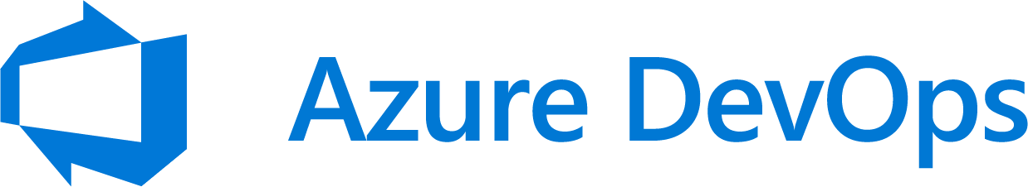

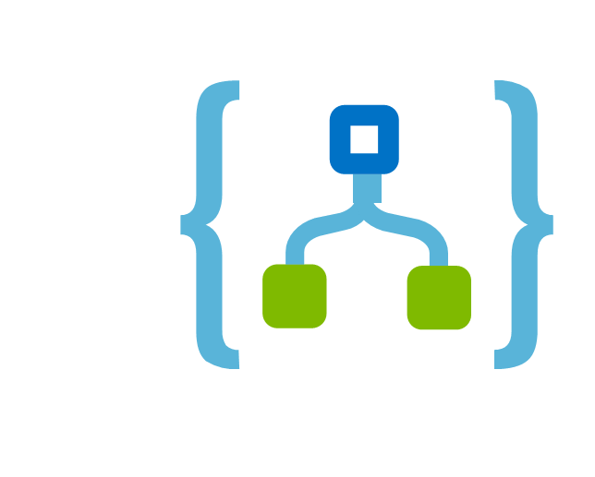
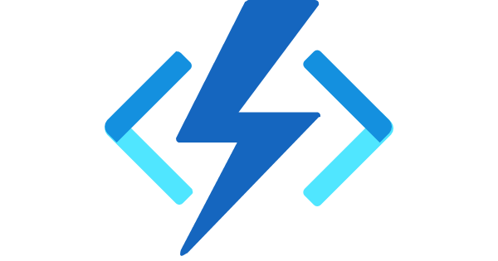
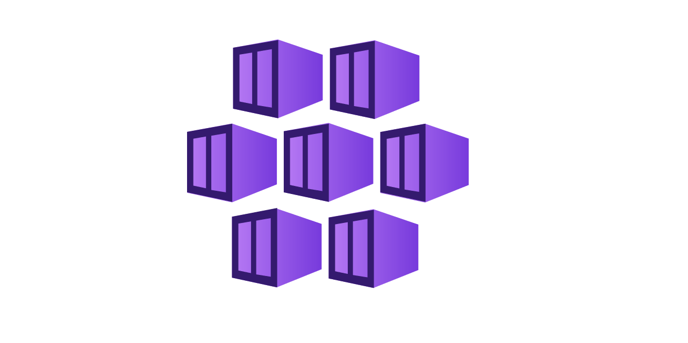


Wrap up
Developer
Device Ordering
App
Admin
Portal
Inventory
Management
Portal
B2B
Public
Website
Consuming
Consuming
Exposed as APIs
Legacy Applications
(ex. mainframe)
Application
Backends
SQL Server
Cosmos DB
Developer
Notes:
Putting everything we said togther, here is a sample application that has several UI interfaces including a Device Ordering App, an admin portal all developed with power apps. This can be integrated with already exiting Inventory management UI, B2B app or even a public website. All of these levergaging logic apps,Azure functions and API management for business opertaions and pulling data from where it resides either via legacy data, SQL server or cosmos db. orchestrate the integration of all of these via Azure DevOps

Slide 9
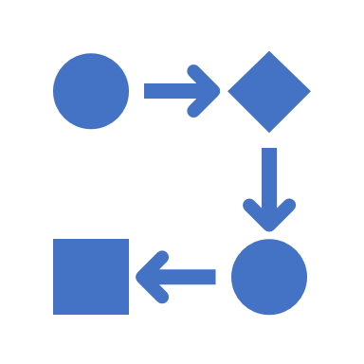

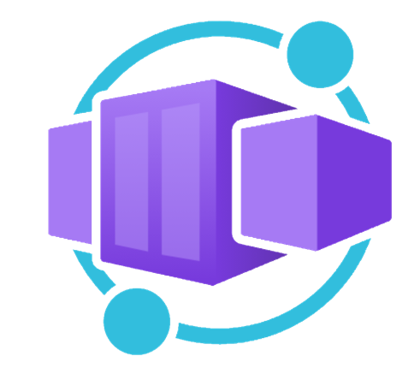



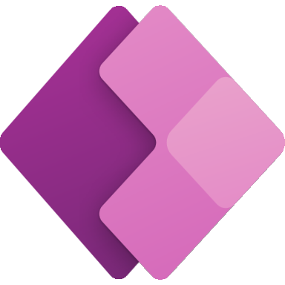
Application hosting continuum
IaaS
Infrastructure Platform
CaaS
Container Orchestration
Platform
PaaS
Application Platform
FaaS
Serverless Platform
Low Code
App and Orchestration
Platform
Virtual Machines
Azure Kubernetes
Service
Azure Container Apps
Azure Spring Apps
Azure App
Service
Azure Functions
Azure Logic
Apps
Power Apps
More Control of execution environment
Less Control of execution environment
Less Agile development & deployment
More Agile development & deployment

Slide 10
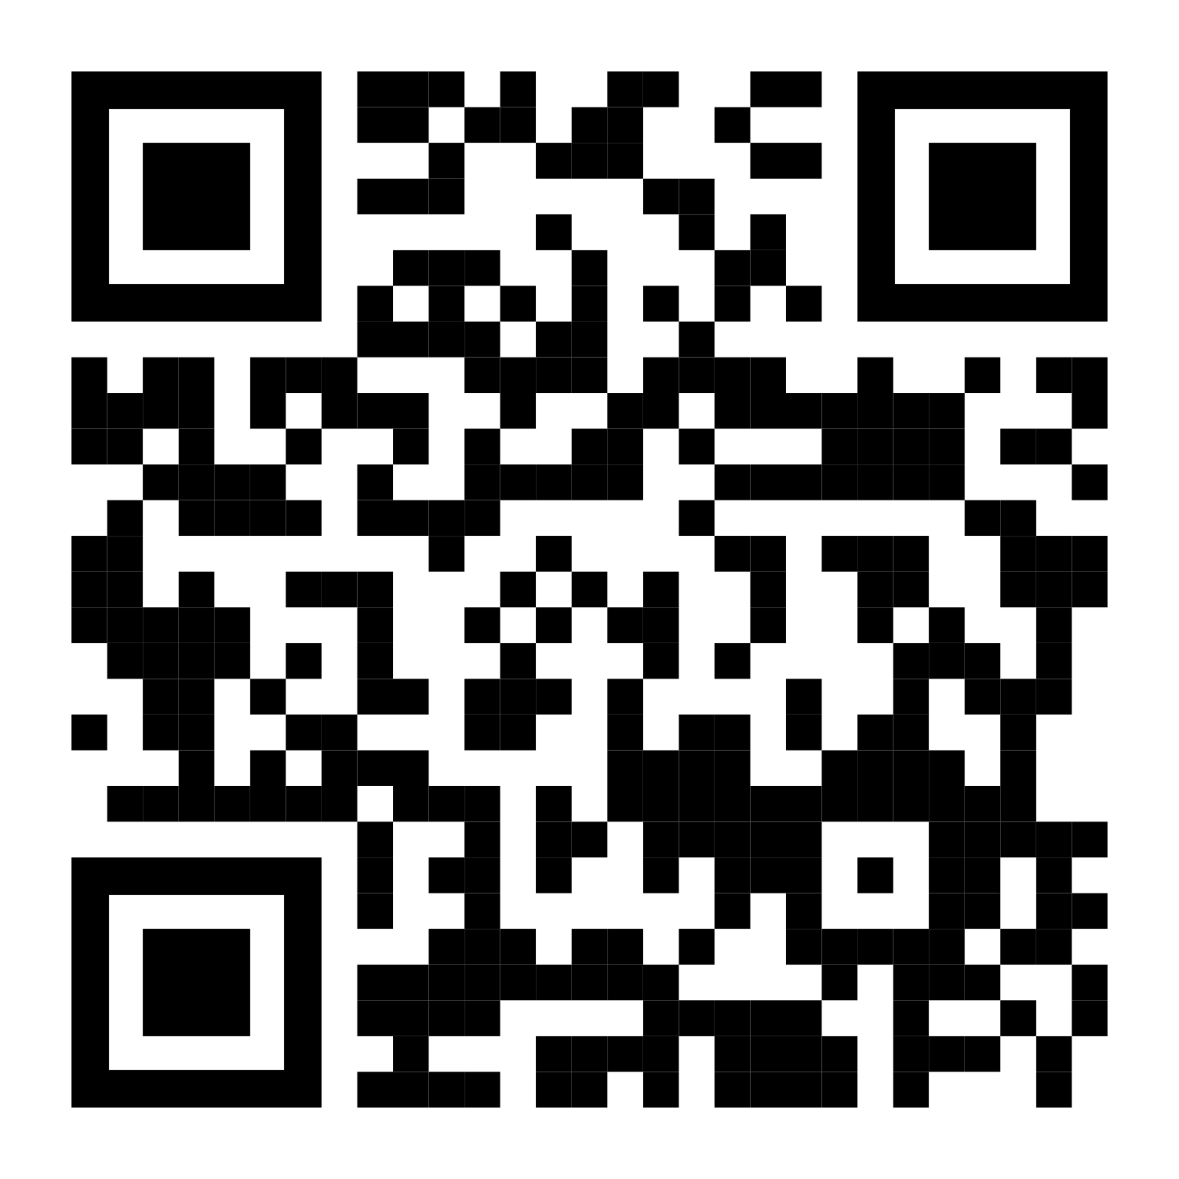
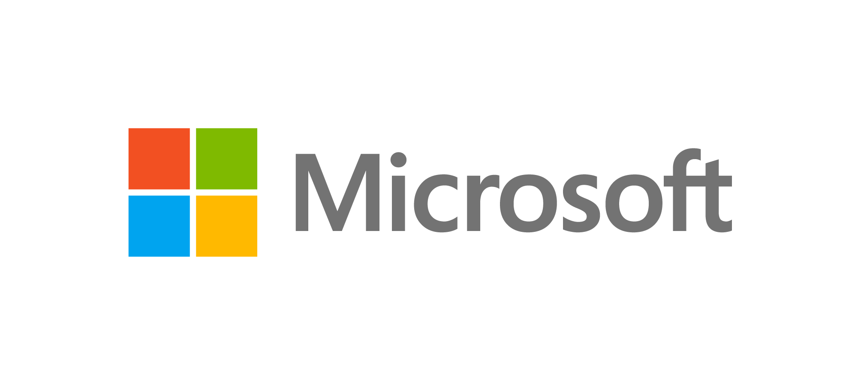
Sign up for Microsoft.Source
Thank you!
Receive a regular digest of relevant technical content, events and training
Get the best of the newest resources, tools and guidance to help developers quickly build and deploy on Azure
Please fill out the Azure Dev Day Survey!
aka.ms/azuredevdaysurvey
And visit our event content page to access lab materials, presentations and more about the Microsoft Build Conference!
aka.ms/azuredevdaycontent
Get the latest articles, documentation, and events from Microsoft.Source—the curated monthly developer community newsletter.
Stay at the forefront of rapidly evolving technologies with resources that are relevant to your field, location, and areas of interest—including articles, GitHub repositories, and how-to guides.
Get notified about events—from local hacks, workshops, and training sessions to virtual meetups and global conferences.
Learn what you want, when you want, how you want. Resources include in-person hands-on workshops, free, interactive online training and sandbox environments.

Slide 11
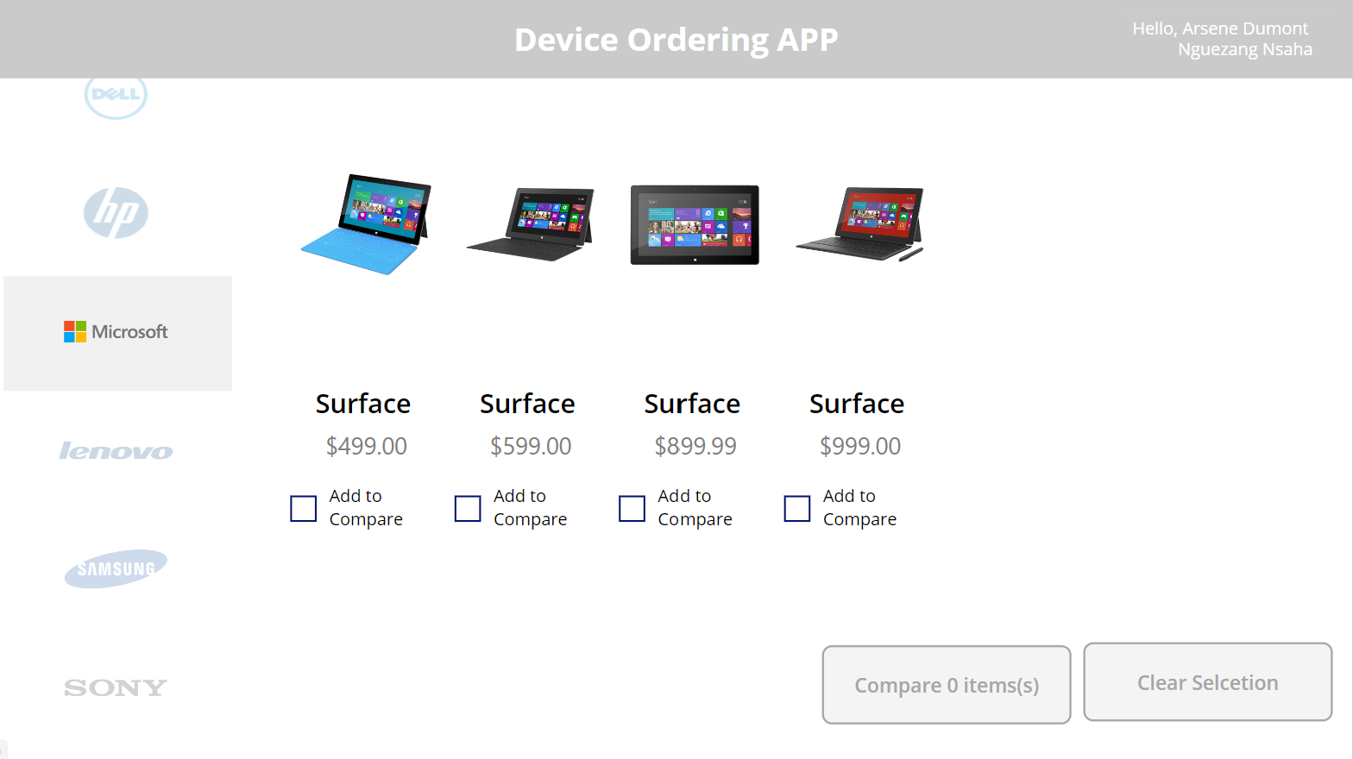
Demo

